Slide 1
ZAS Academy
Python Curriculum for IOT & AI

Slide 2
Day7 - Agenda
Day 7
Blynking LED
Touch sensor
DHT11 sensor
Touch sensor Email
Ultrasonic sensor

Slide 3
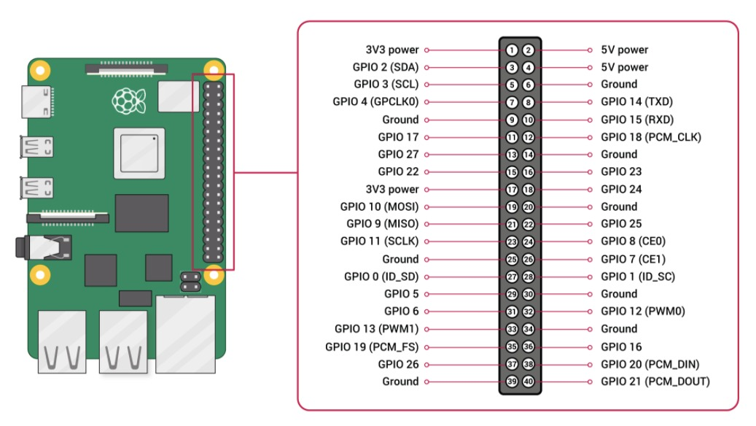
Pi Pin Diagram

Slide 4
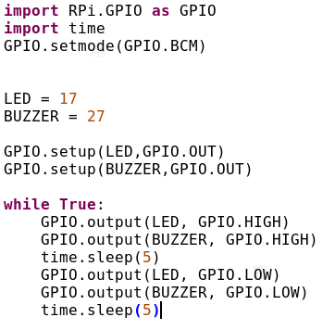
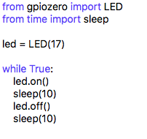
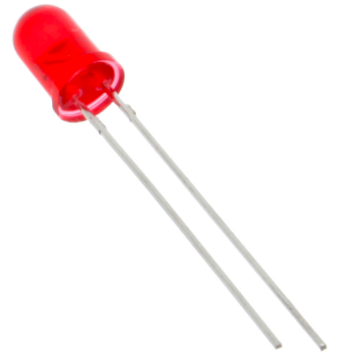
PILED

Slide 5
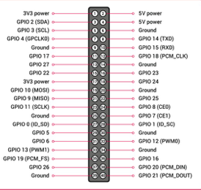
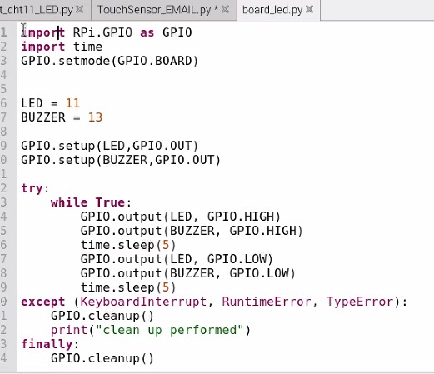
PILED
B
O
A
R
D
B
C
M

Slide 6
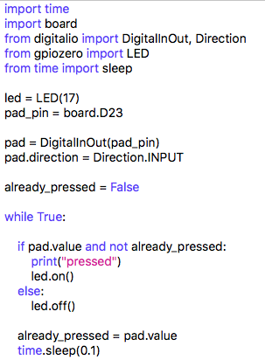
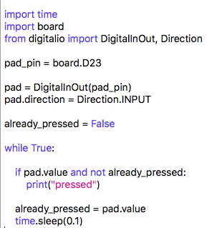
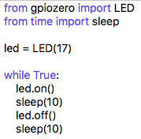
Touch Sensor

Slide 7
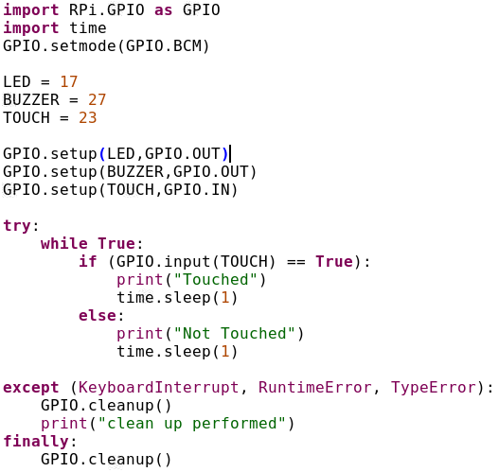
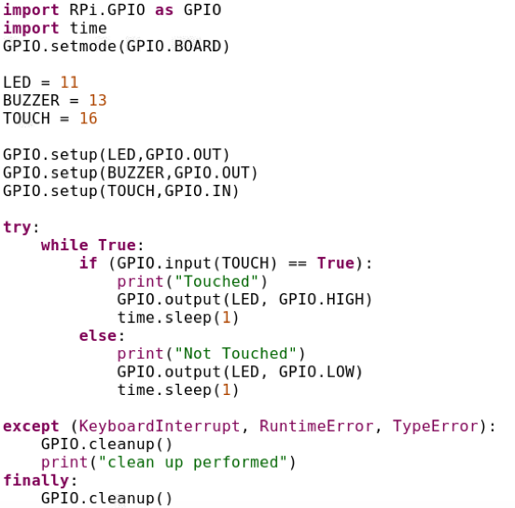
Touch Sensor BCM & Board
Library
BCM
BOARD

Slide 8
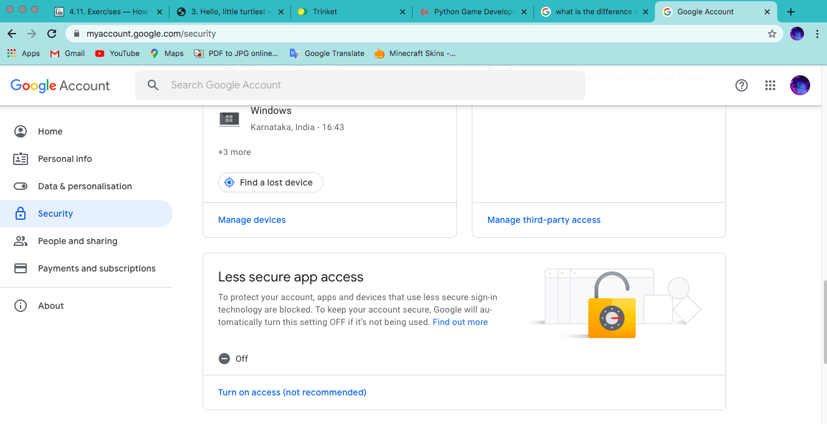
Gmail Settings

Slide 9
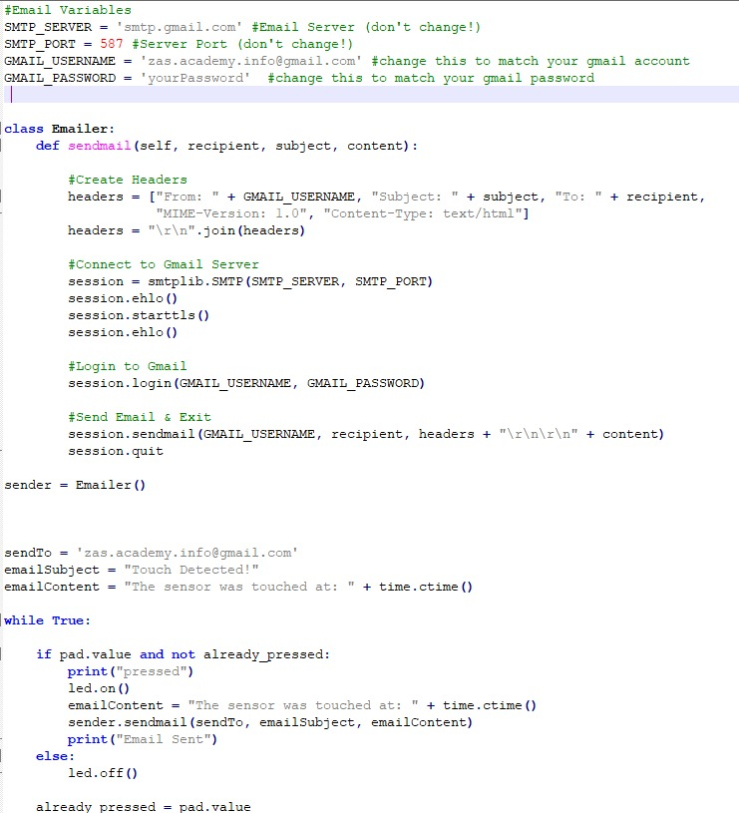
Email Settings

Slide 10
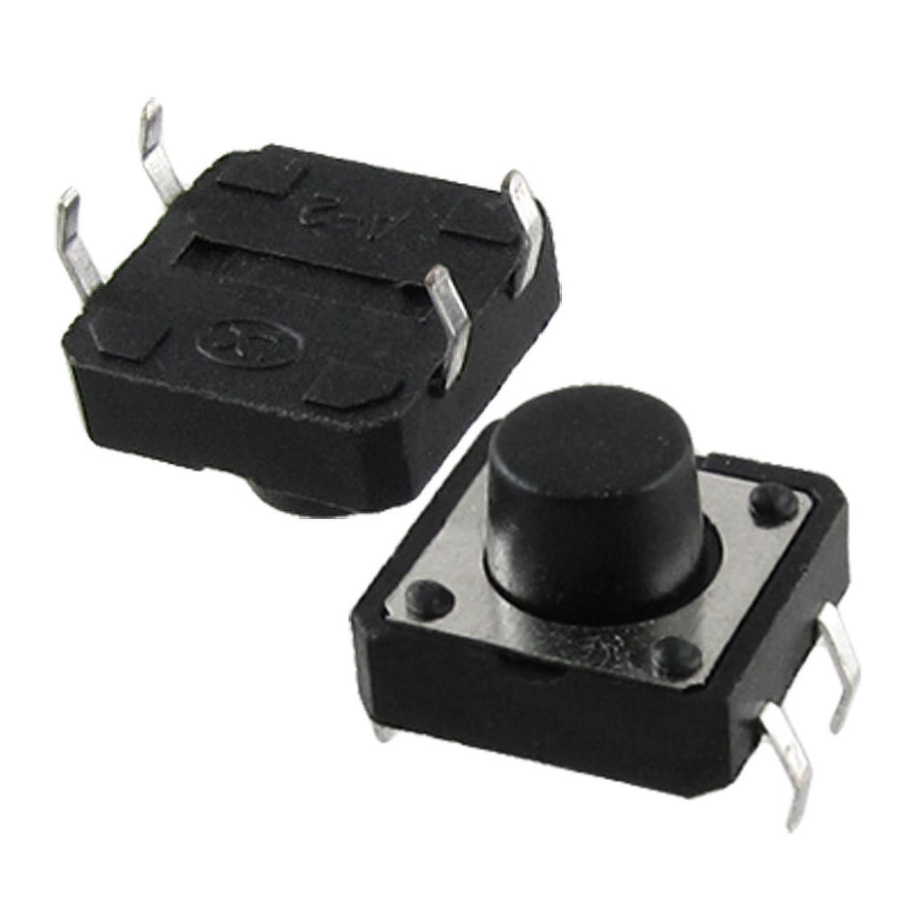
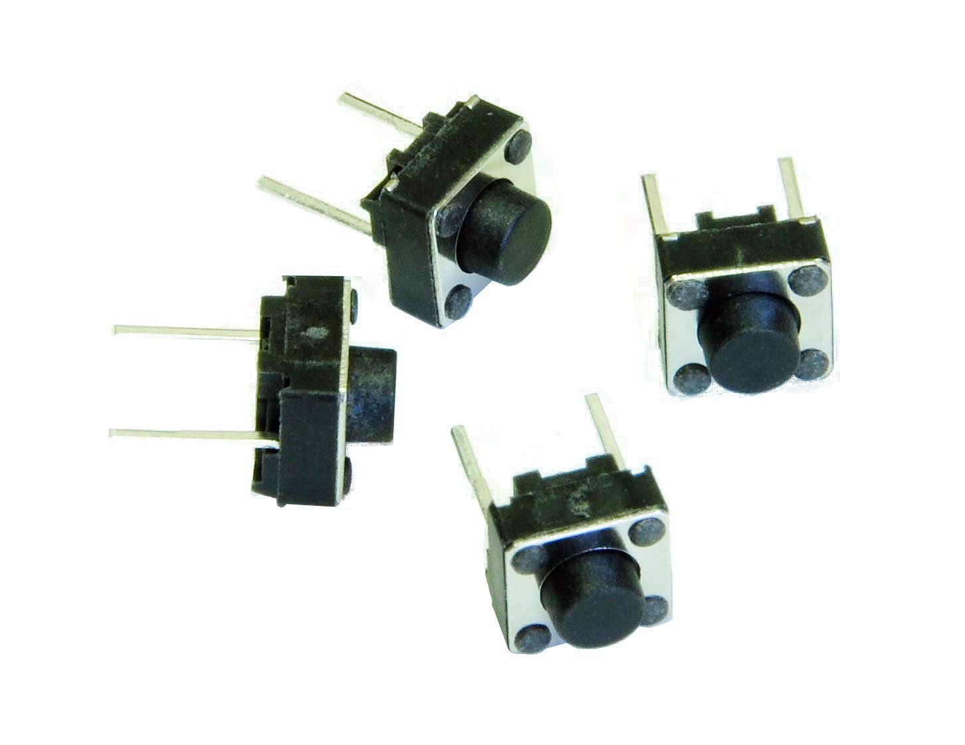
Switch

Slide 11
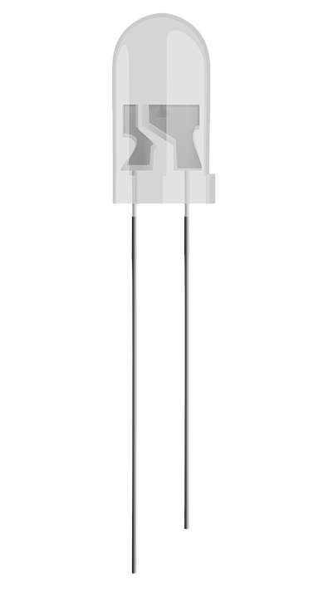
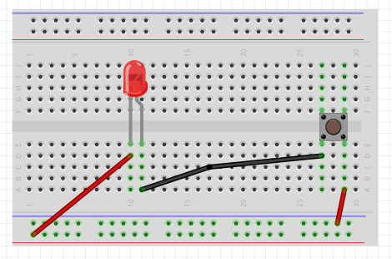
LED, Battery and Switch
Long leg - positive
Short leg - Negative
Negative
Positve

Slide 12
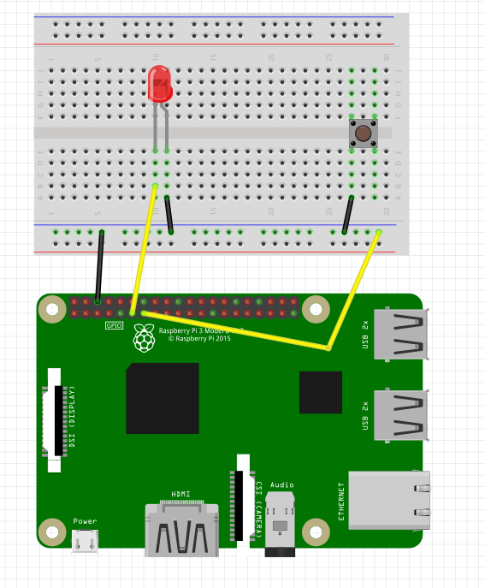
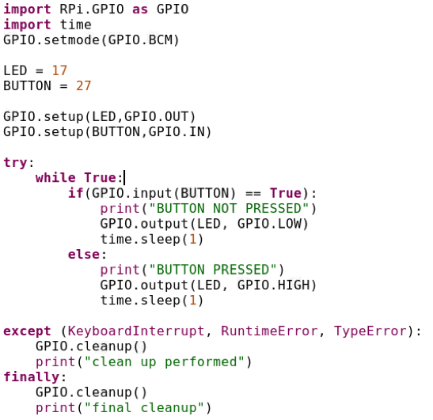
Button
Input GPIO Pins are Pulled High by default

Slide 13
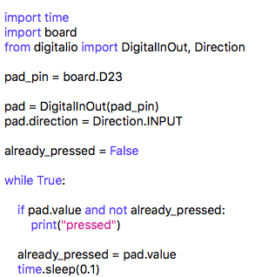
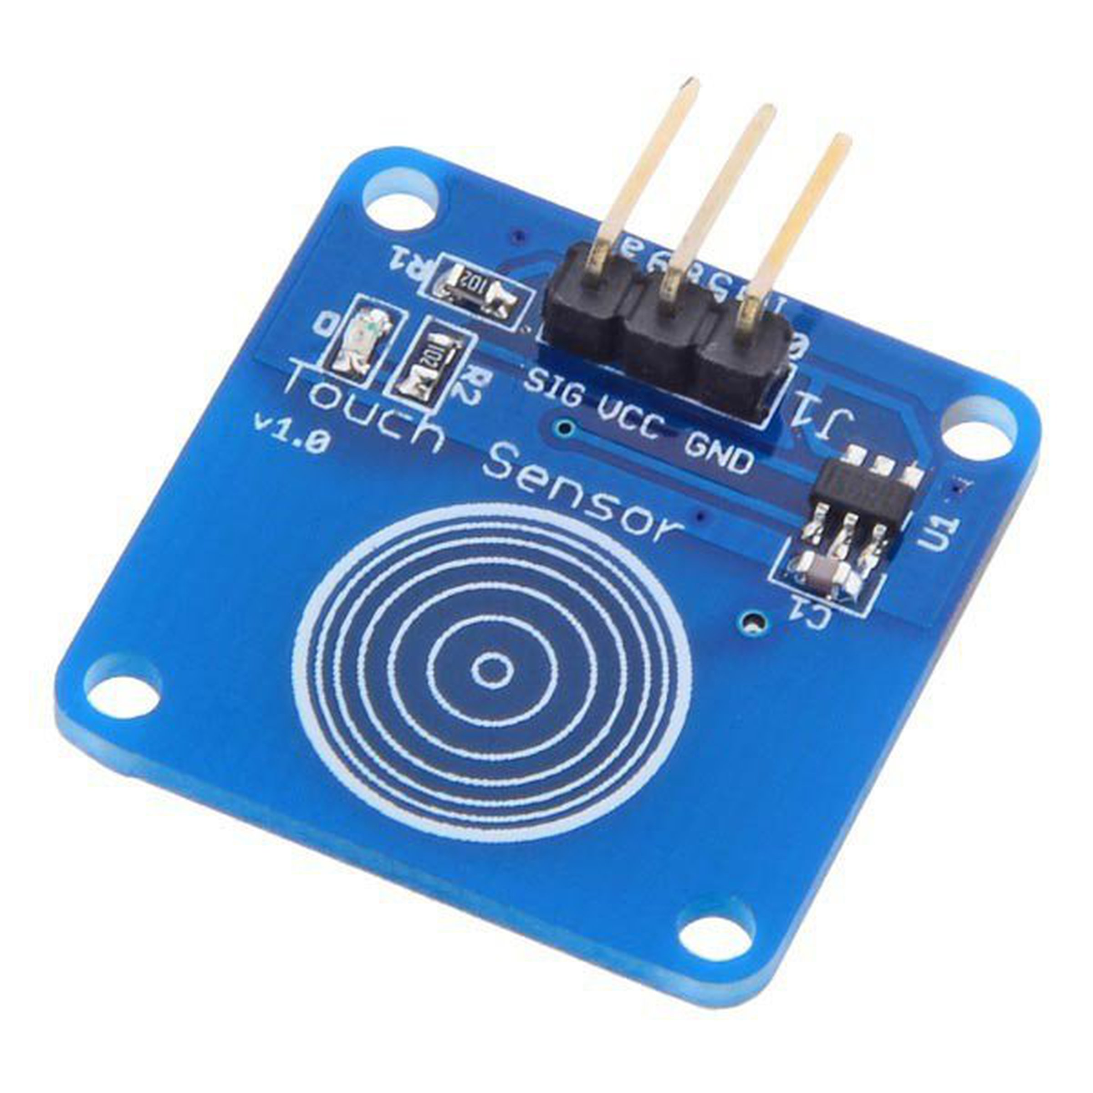
Touch Sensor

Slide 14
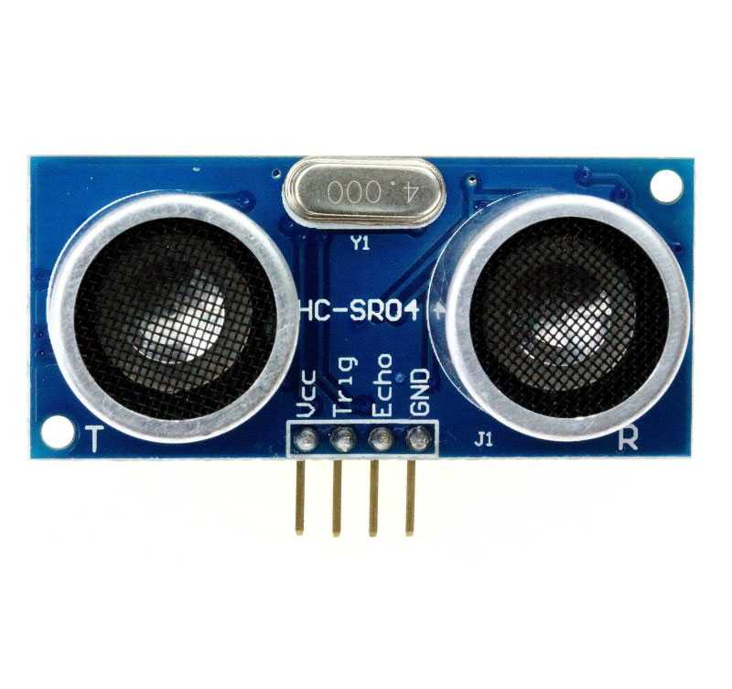
Ultrasonic Sensor
It has 4 pins
VCC
Trig
Echo
Gnd

Slide 15
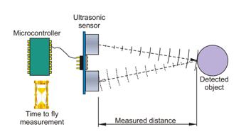
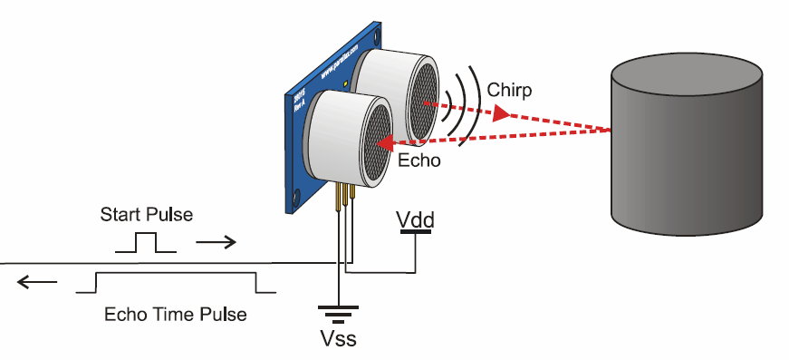
How Does Ultrasonic Sensor Works?
Trigger
Echo

Slide 16
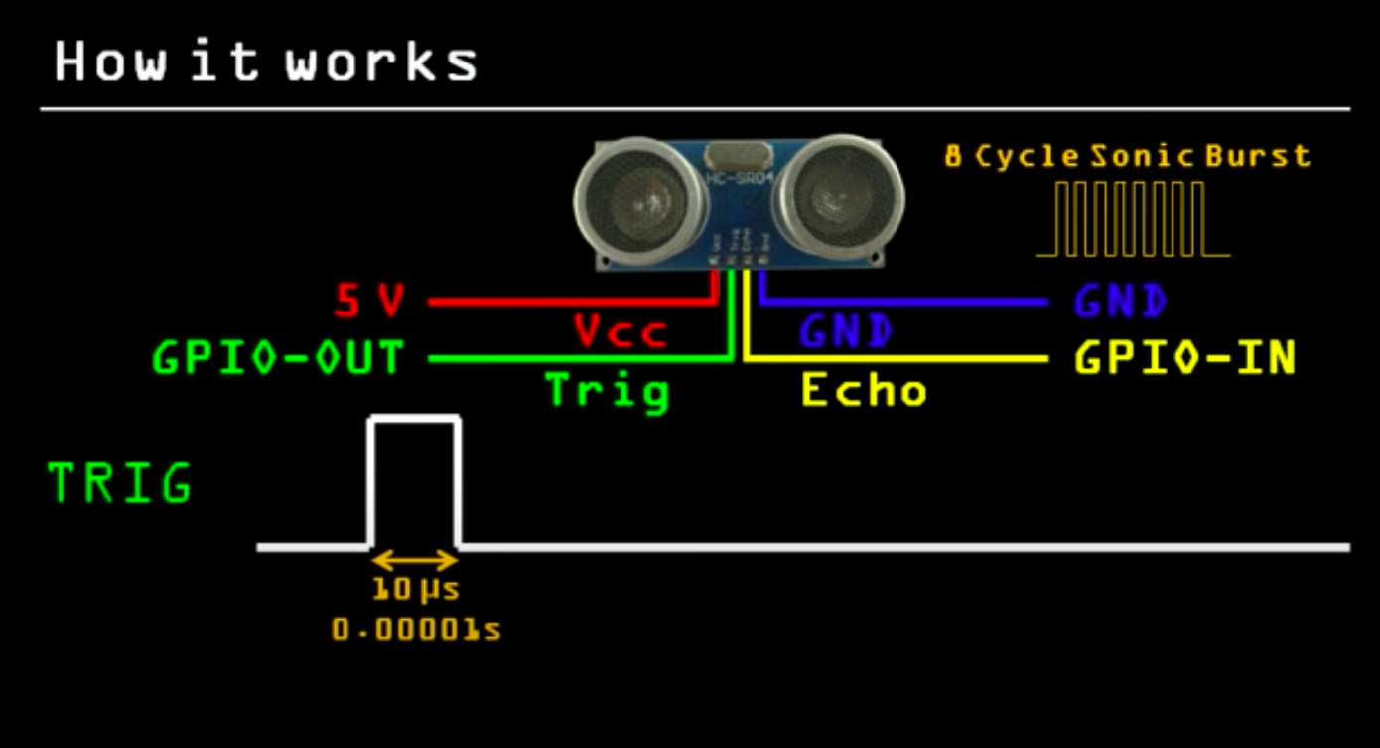

Slide 17
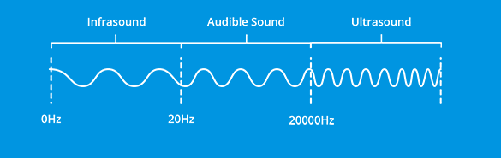
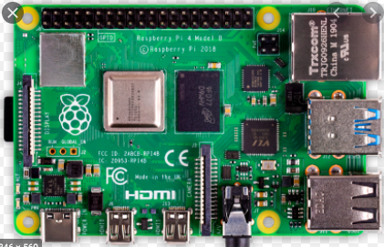
How Does Ultrasonic Sensor Works?
Trig
Echo

Slide 18
Calculating Distance
D
Distance = Speed x Time
Time = EchoTime/2
Speed = Speed of Sound = 340 m/s = 34000 cm/s
T
S
Distance = (Speed x EchoTime/2)

Slide 19
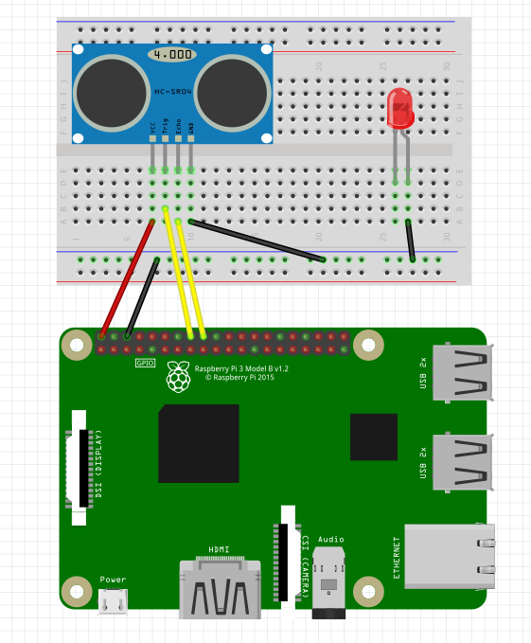
Connections

Slide 20
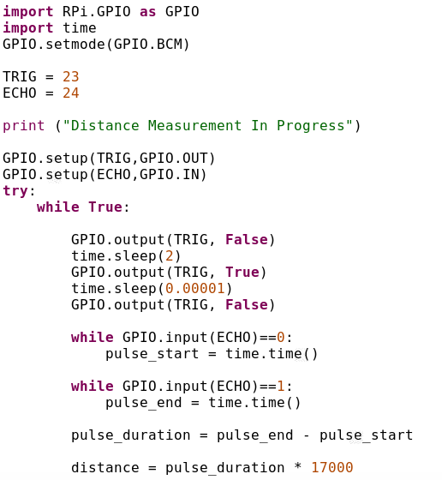
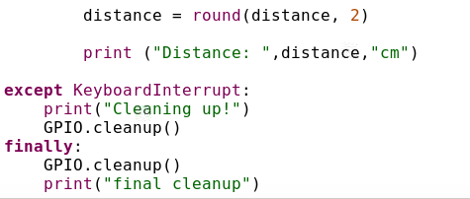
Ultrasonic Sensor
TrigPin
HIGH
10 us
2s
LOW

Slide 21
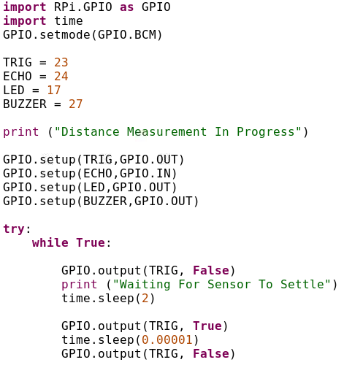
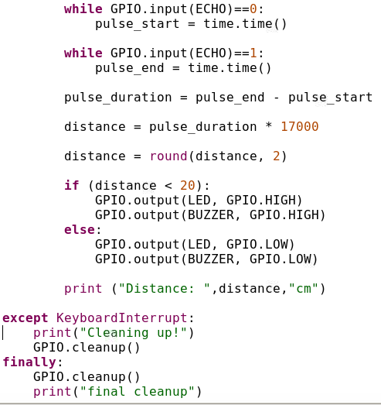
Ultrasonic+LED

